Slide 1
Atmospheric Turbulence
Lecture 2, ASTR 289
Claire Max
UC Santa Cruz
January 14, 2020

Slide 2
Observing through Earth’s Atmosphere
"If the Theory of making Telescopes could at length be fully brought into Practice, yet there would be certain Bounds beyond which telescopes could not perform …
For the Air through which we look upon the Stars, is in perpetual Tremor ...
The only Remedy is a most serene and quiet Air, such as may perhaps be found on the tops of the highest Mountains above the grosser Clouds."
Isaac Newton

Slide 3
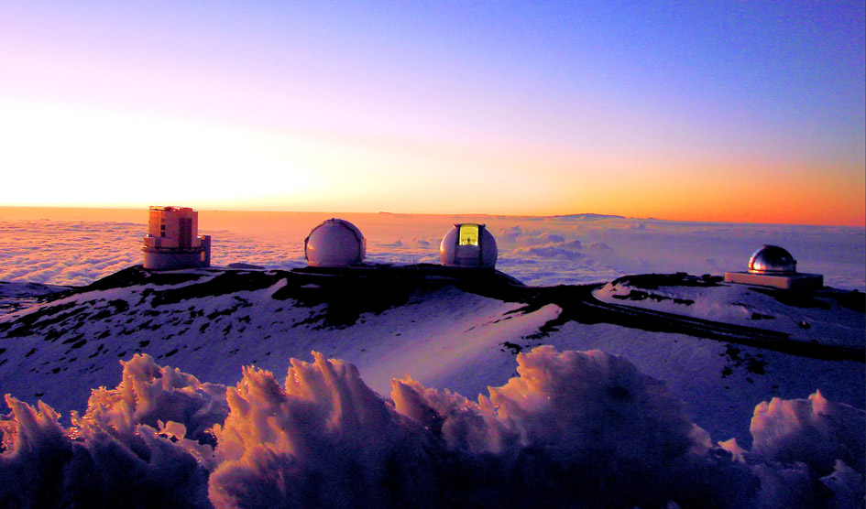
Newton was right!
Summit of Mauna Kea, Hawaii (14,000 ft)

Slide 4
Outline of lecture
Physics of turbulence in the Earth’s atmosphere
  Location
  Origin
  Energy sources
Mathematical description of turbulence

Slide 5
Atmospheric Turbulence: Main Points
The dominant locations for index of refraction fluctuations that affect astronomers are the atmospheric boundary layer and the tropopause (we will define these)
Atmospheric turbulence (mostly) obeys “Kolmogorov statistics”
Kolmogorov turbulence is derived from dimensional analysis (heat flux in = heat flux in turbulence)
Structure functions (we will define these!) derived from Kolmogorov turbulence are
All else will follow from these points!

Slide 6
Atmospheric Turbulence: Topics
What determines the index of refraction in air?
Origins of turbulence in Earth’s atmosphere
Energy sources for turbulence
Kolmogorov turbulence models

Slide 7
Index of refraction of air
Refractivity of air
  where P = pressure in millibars, T = temp. in K, λ in microns
  n = index of refraction.
Key points:
  Index of refraction is very close to unity
  Wavelength dependence of index of refraction is very weak!
    Less than 1% effect at wavelengths ~ 1 micron

Slide 8
Fluctuations in index of refraction are due to temperature fluctuations
Temperature fluctuations → index fluctuations
Take derivative of expression on previous slide
  (pressure is constant, because velocities are highly sub-sonic -- pressure differences are rapidly smoothed out by sound wave propagation)

Slide 9
Turbulence arises in many places (part 1)
stratosphere
tropopause
10-12 km
wind flow around dome
boundary layer
~ 1 km
Heat sources w/in dome

Slide 10
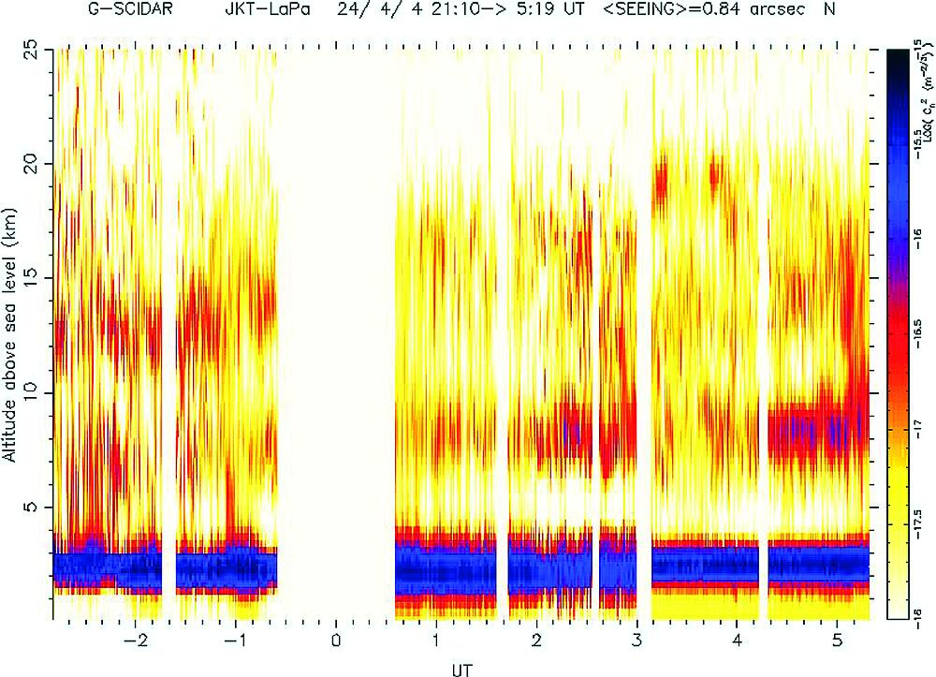
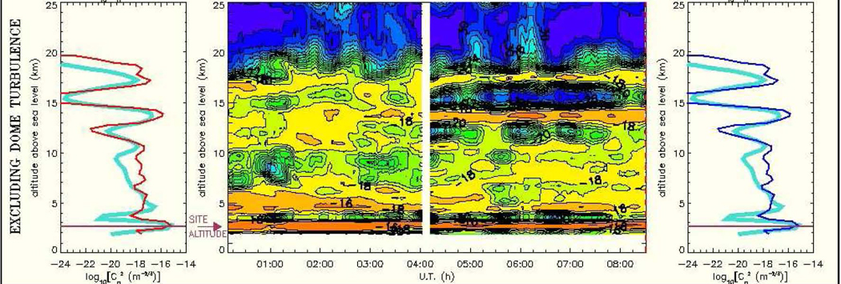
Two examples of measured atmospheric turbulence profiles
Credit: cute-SCIDAR group, J. J. Fuensalida, PI

Slide 11
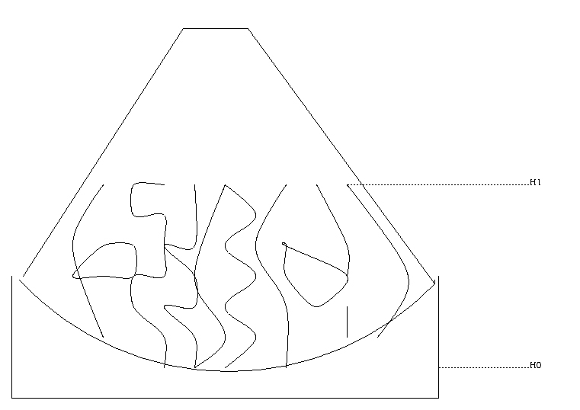
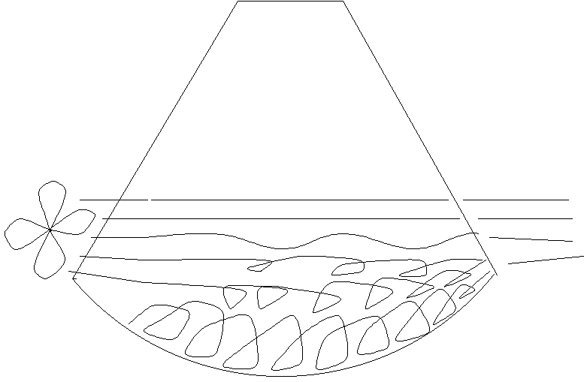
Turbulence within dome: “mirror seeing”
When a mirror is warmer than dome air, convective equilibrium is reached.
Remedies: Cool mirror itself, or blow air over it.
credit: M. Sarazin
credit: M. Sarazin
convective cells are bad
To control mirror temperature: dome air conditioning (day), blow air on back (night), send electric current through front Al surface-layer to equalize temperature between front and back of mirror

Slide 12
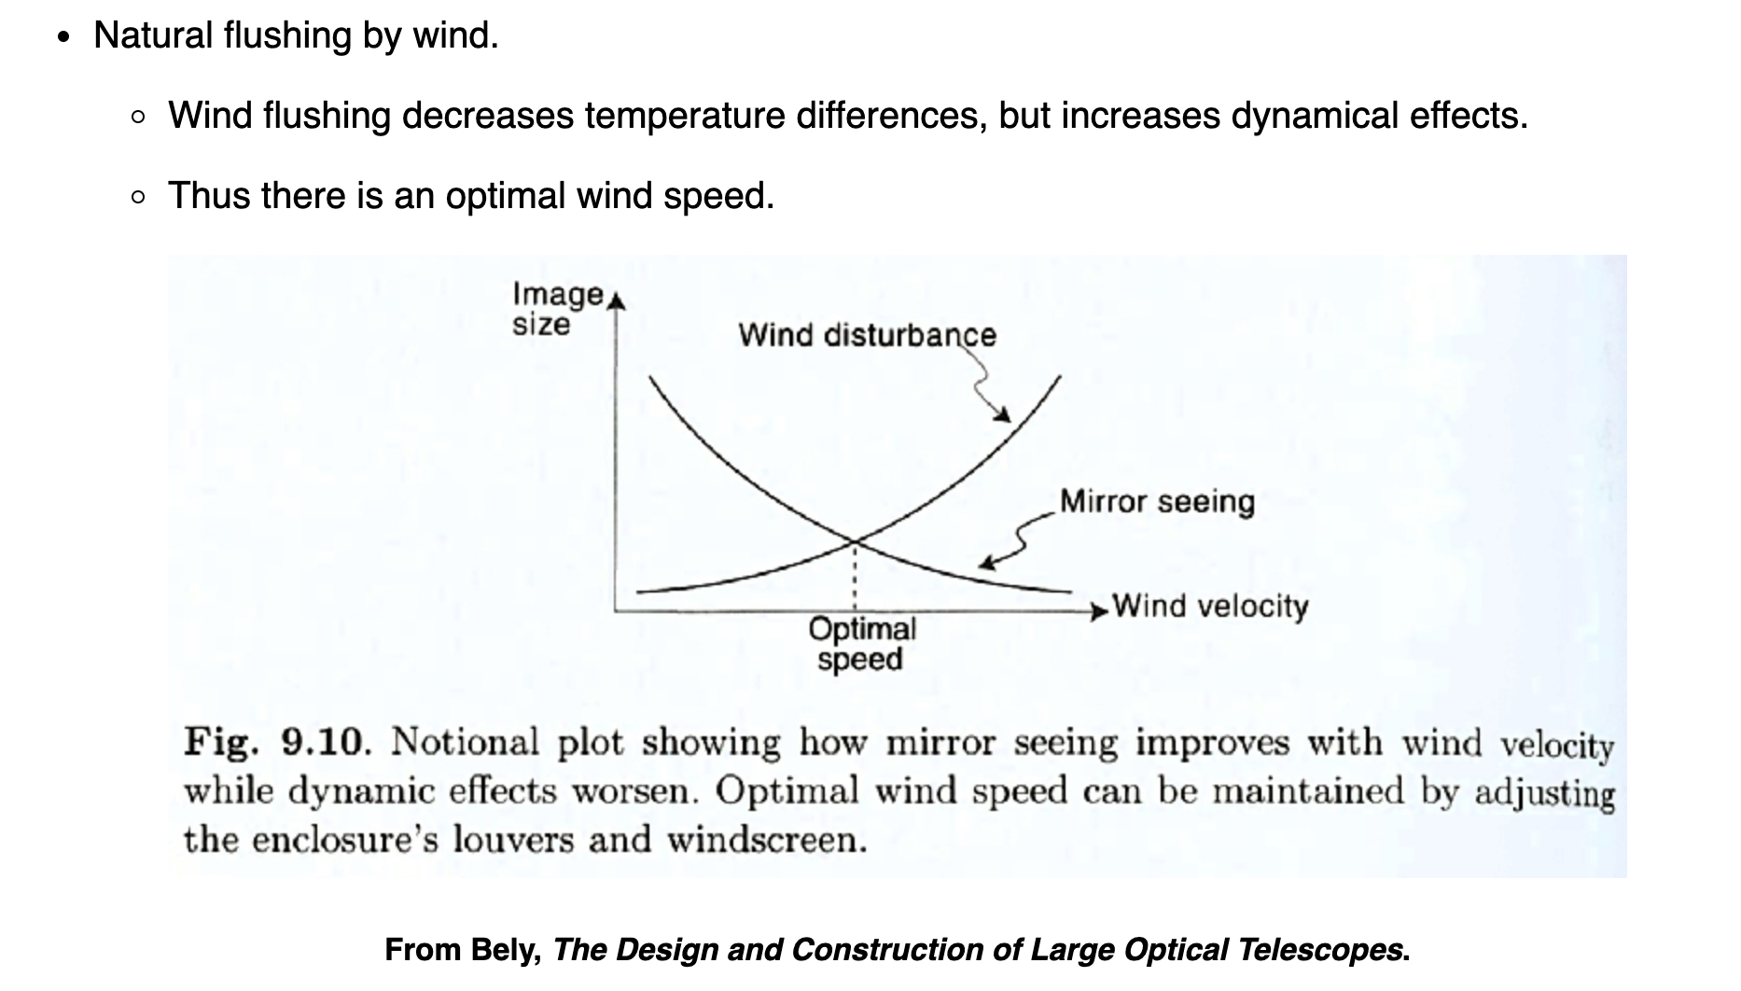
Natural flushing by wind can frequently reduce “mirror seeing”
Credit: Majewski, Univ. of Virginia

Slide 13
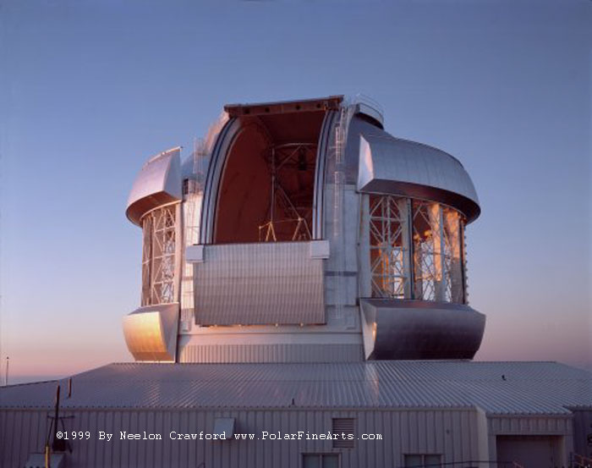
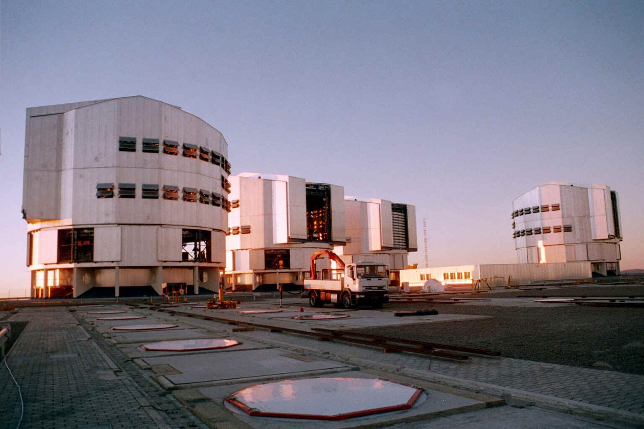
Modern observatory domes have louvres to let wind flow through
Gemini dome
VLT Domes

Slide 14
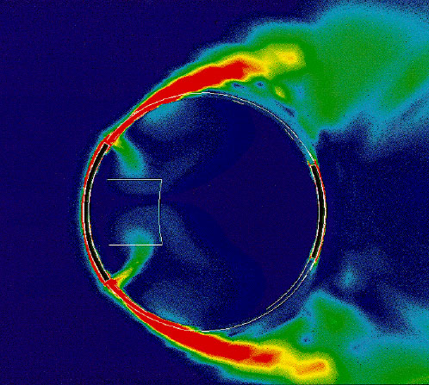
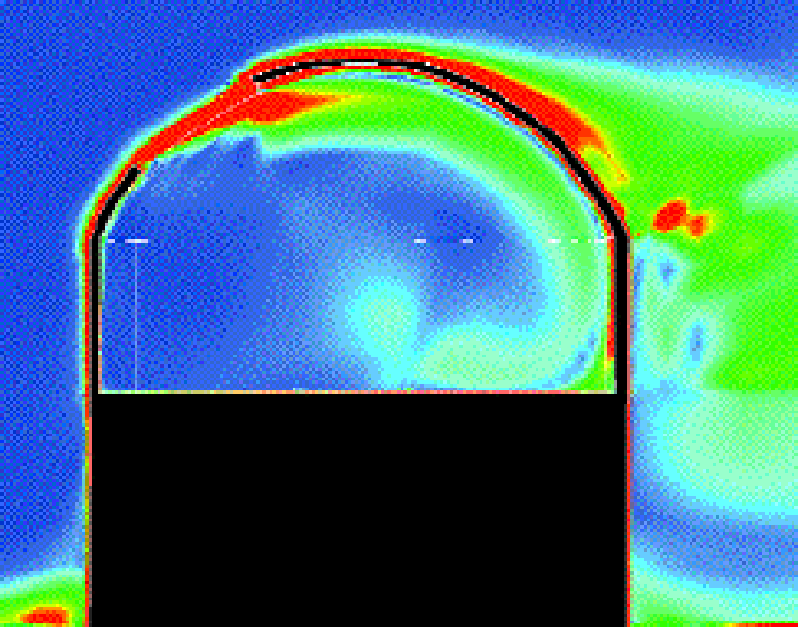
Turbulence also arises from wind flowing over the telescope dome
“Wake Turbulence” – you may not want to point telescope in direction opposite to wind, on windy night
Computational fluid dynamics simulation (D. de Young)

Slide 15
Turbulent boundary layer has largest effect on “seeing”
Wind speed must be zero at ground, must equal v_{wind} several hundred meters up (in the “free” atmosphere)
Adjustment takes place at bottom of boundary layer
  Where atmosphere feels strong influence of surface
  Turbulent viscosity slows wind speed to zero
Quite different between day and night
  Daytime: boundary layer is thick (up to a km), dominated by convective plumes rising from hot ground. Quite turbulent.
  Night-time: boundary layer collapses to a few hundred meters, is stably stratified. See a few “gravity waves.” Perturbed if winds are high.

Slide 16
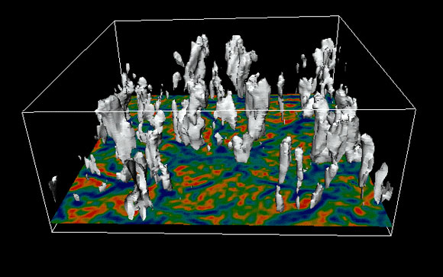
Convection takes place when temperature gradient is steep
Daytime: ground is warmed by sun, air is cooler
If temp. gradient between ground and ~ 1 km is steeper than “adiabatic gradient,” warm volume of air raised upwards will have cooler surroundings, will keep rising
These warm volumes of air carry thermal energy upwards
UCAR large eddy simulation of convective boundary layer

Slide 17
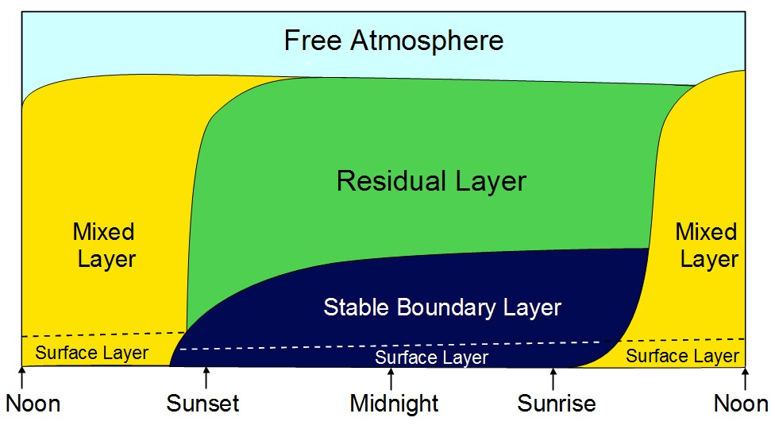
Boundary layer is much thinner at night:
Day ~ 1 km, Night ~ few hundred meters
Couldn’t find source for this figure
Surface layer: where viscosity is largest effect
Daytime convection

Slide 18
Implications: solar astronomers vs. night-time astronomers
Daytime: Solar astronomers have to work with thick and messy turbulent boundary layer
Night-time: Less total turbulence, but still the single largest contribution to “seeing”
Neutral times: near dawn and dusk
  Smallest temperature difference between ground and air, so wind shear causes smaller temperature fluctuations

Slide 19
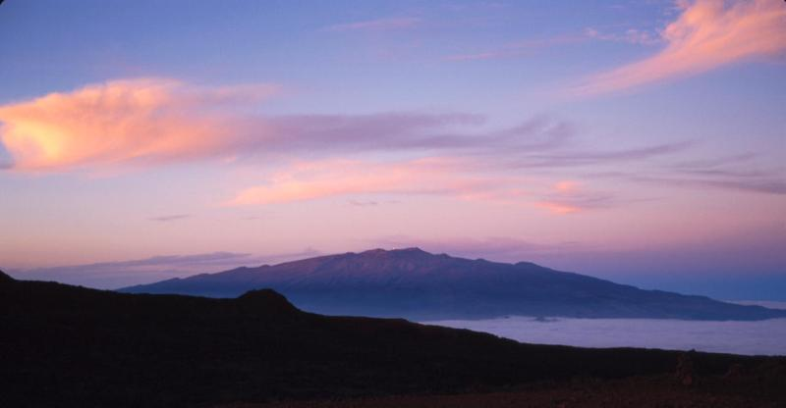
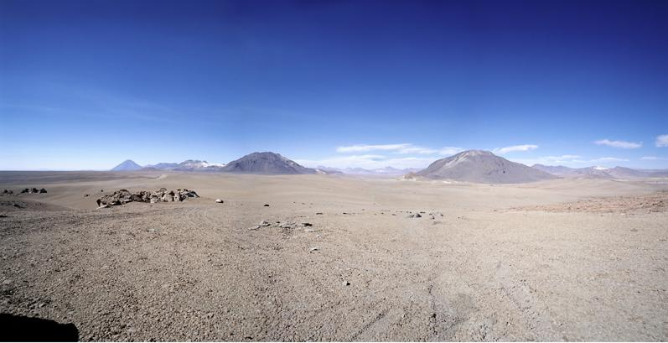
Concept Question
Think of as many reasons as you can why high mountain tops have the best “seeing” (lowest turbulence). Prioritize your hypotheses from most likely to least likely.
Use analogous reasoning to explain why the high Atacama Desert in Chile also has excellent “seeing”.
Mauna Kea, Hawaii
Atacama Desert, Chile

Slide 20
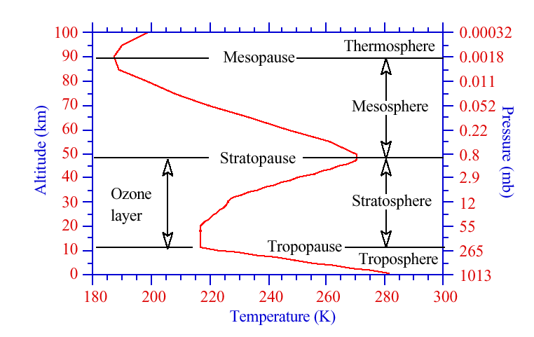
Turbulence in the “free atmosphere” above the boundary layer
Strong wind
shear at tropopause

Slide 21
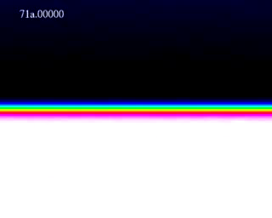
Wind shear mixes layers with different temperatures
Wind shear → Kelvin Helmholtz instability
If two regions have different temperatures, temperature fluctuations δT will result
T fluctuations ⟹ index of refraction fluctuations
Computer simulation by Ceniceros and Roma, UCSB

Slide 22
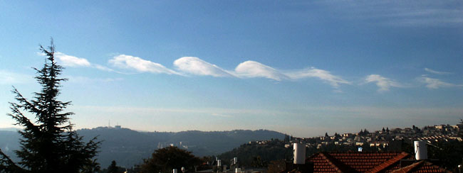
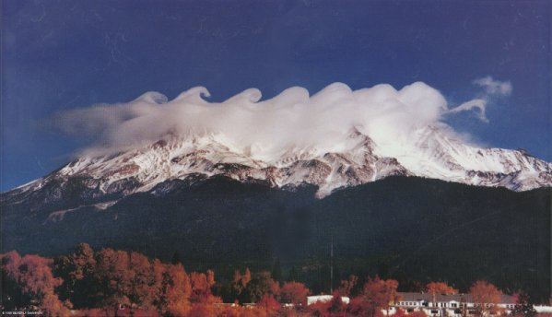
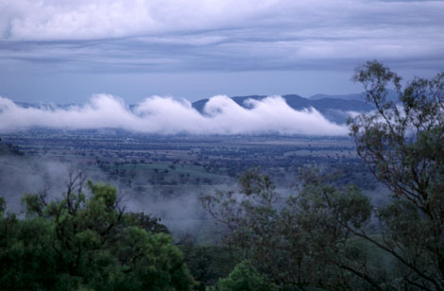
Sometimes clouds show great Kelvin-Helmholtz vortex patterns
A clear sign of wind shear

Slide 23
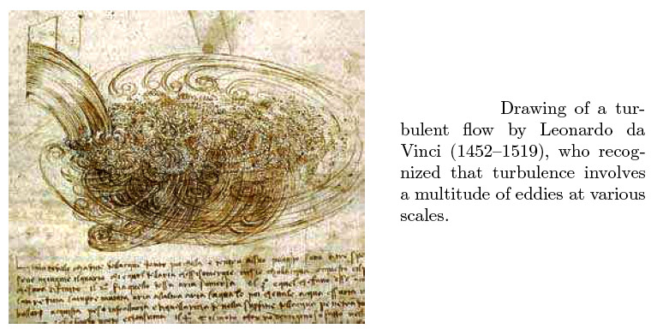
Leonardo da Vinci’s view of turbulence

Slide 24
Kolmogorov turbulence in a nutshell
Big whorls have little whorls,
Which feed on their velocity;
Little whorls have smaller whorls,
And so on unto viscosity.
L. F. Richardson (1881-1953)

Slide 25
Kolmogorov turbulence, cartoon
solar
Outer scale L₀
Inner scale l₀
hν
Wind shear
convection
hν
ground

Slide 26
Kolmogorov turbulence, in words
Assume energy is added to system at largest scales - “outer scale” L₀
Then energy cascades from larger to smaller scales (turbulent eddies “break down” into smaller and smaller structures).
Size scales where this takes place: “Inertial range”.
Finally, eddy size becomes so small that it is subject to dissipation from viscosity. “Inner scale” l₀
L₀ ranges from 10’s to 100’s of meters; l₀ is a few mm

Slide 27
Breakup of Kelvin-Helmholtz vortex
Start with large coherent vortex structure, as is formed in K-H instability
Watch it develop smaller and smaller substructure
Analogous to Kolmogorov cascade from large eddies to small ones
http://www.youtube.com/watch?v=hUXVHJoXMmU

Slide 28
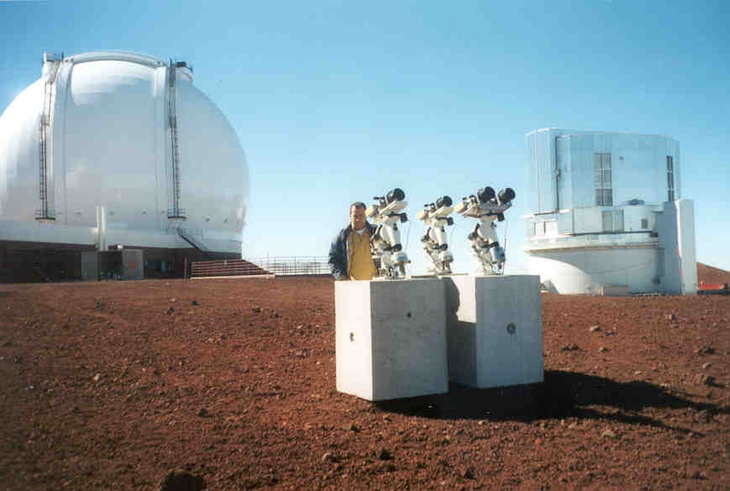
How large is the Outer Scale?
Dedicated instrument, the Generalized Seeing Monitor (GSM), built by Dept. of Astrophysics, Nice Univ.)

Slide 29
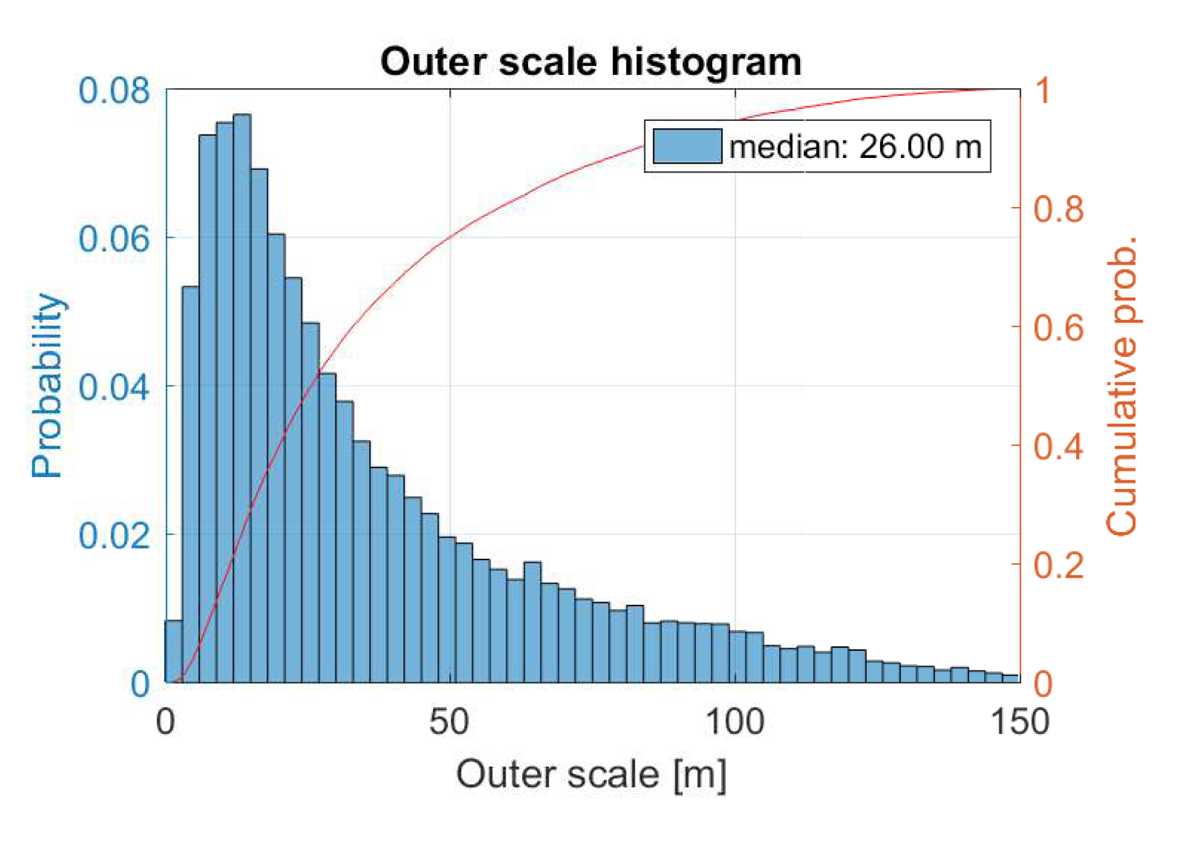
Median Outer Scale ~ 25-30 m, from Generalized Seeing Monitor measurements at Calern, Fr
Aristidi et al. 2019

Slide 30
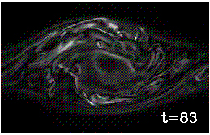
Concept Question
What do you think really determines the outer scale in the boundary layer? At the tropopause?
Hints:

Slide 31
The Kolmogorov turbulence model, derived from dimensional analysis (1)
v = velocity, ε = energy dissipation rate per unit mass,
= viscosity, l₀ = inner scale, l = local spatial scale
Energy/mass = v²/2 ~ v²
Energy dissipation rate per unit mass
  ε ~ v²/τ = v² / (l / v) = v³ / l
  v ~ (ε l )^{1/3}
  Energy v² ~ ε ^{2/3} l ^{2/3}

Slide 32
Kolmogorov Turbulence Model (2)
1-D power spectrum of velocity fluctuations: k = 2π / l
Φ(k) Δk ~ v² ~ ( ε l )^{2/3} ~ ε ^{2/3} k ^{-2/3} or, dividing by k,
  Φ(k) ~ k ^{-5/3} (one dimension)
3-D power spectrum: Φ^{3D}(k) ~ Φ / k ²
  Φ^{3D}(k) ~ k ^{-11/3} (3 dimensions)
For a more rigorous calculation: V. I. Tatarski, 1961, “Wave Propagation in a Turbulent Medium”, McGraw-Hill, NY

Slide 33
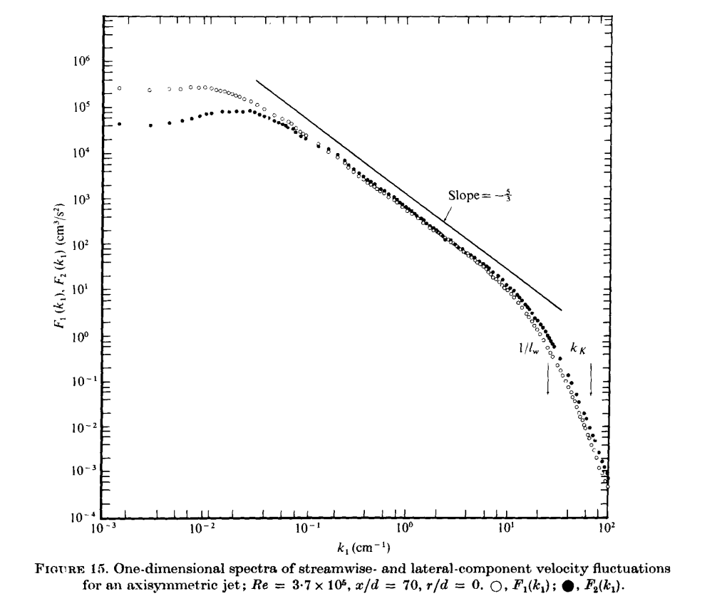
Lab experiments agree
Air jet, 10 cm diameter (Champagne, 1978)
Assumptions: turbulence is homogeneous, isotropic, stationary in time
Slope -5/3
L₀
Power (arbitrary units)
l₀
κ (cm⁻¹)

Slide 34
The size of the inertial range is related to the Reynolds number
Outer scale of turbulence: L₀
  Size of the largest turbulent eddy
Inner scale of turbulence: l₀
  Below this scale, collisional viscosity wipes out any remaining velocity gradients
Can show that
“Fully developed turbulence”: Re > 5 x 10³ (or more)

Slide 35
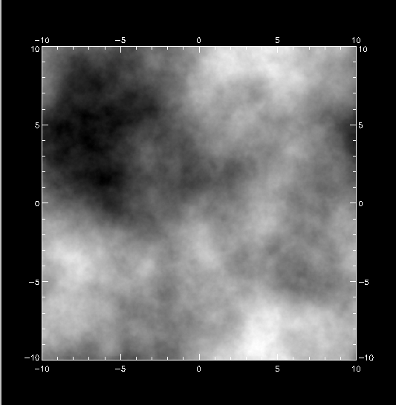
What does a Kolmogorov distribution of phase look like?
A Kolmogorov “phase screen” courtesy of Don Gavel
Shading (black to white) represents phase differences of ~1.5 μm
r₀ = 0.4 meter
Position (meters)
Position (meters)

Slide 36
Structure functions are used a lot in AO discussions. What are they?
Mean values of meteorological variables change over minutes to hours. Examples: T, p, humidity
If f(t) is a non-stationary random variable,
  F_{t}(τ) = f ( t +τ) - f ( t) is a difference function that is stationary for small τ .
Structure function is measure of intensity of fluctuations of f (t) over a time scale less than or equal to τ :
  D_{f}(τ) = < [ F_{t}(τ) ]²> = < [ f (t + τ) - f ( t) ]² >

Slide 37
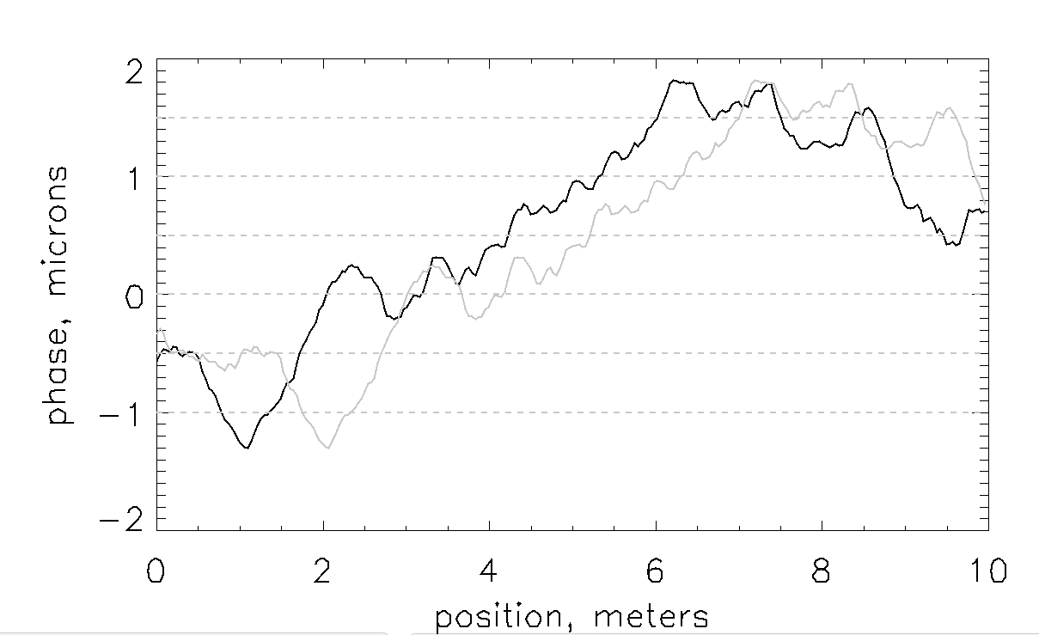
More about the structure function (1)

Slide 38
Structure function for atmospheric fluctuations, Kolmogorov turbulence
Scaling law we derived earlier: v² ~ ε^{2/3} l^{2/3} ~ r ^{2/3} where r is spatial separation between two points
Heuristic derivation: Velocity structure function ~ v²
Here C_{v}² = constant to clean up “look” of the equation

Slide 39
Derivation of D_{v} from dimensional analysis (1)
If turbulence is homogenous, isotropic, stationary
  where f is a dimensionless function of a dimensionless argument.
Dimensions of α are v², dimensions of β are length, and they must depend only on ε and ν (the only free parameters in the problem).
  [ ν ] ~ cm² s⁻¹ [ ε ] ~ erg s⁻¹ gm⁻¹ ~ cm² s⁻³

Slide 40
Derivation of D_{v} from dimensional analysis (2)
The only combinations of ε and ν with the right dimensions are

Slide 41
What about temperature and index of refraction fluctuations?
Temperature fluctuations are carried around passively by velocity field (incompressible fluids).
So T and N have structure functions similar to v:
D_{T} ( r ) = < [ T (x ) - T ( x + r ) ]² > = C_{T}² r ^{2/3}
D_{N} ( r ) = < [ N (x ) - N ( x + r ) ]² > = C_{N}² r ^{2/3}

Slide 42
How do you measure index of refraction fluctuations in situ?
Refractivity
Index fluctuations
So measure δT , p, and T; calculate C_{N}²

Slide 43
Simplest way to measure C_{N}² is to use fast-response thermometers
D_{T} ( r ) = < [ T (x ) - v ( T + r ) ]² > = C_{T}² r ^{2/3}
Example: mount fast-response temperature probes at different locations along a bar:
X X X X X X
Form spatial correlations of each time-series T(t)

Slide 44
Assumptions of Kolmogorov turbulence theory
Medium is incompressible
External energy is input on largest scales (only), dissipated on smallest scales (only)
  Smooth cascade
Valid only in inertial range l << L₀
Turbulence is
  Homogeneous
  Isotropic
In practice, Kolmogorov model works surprisingly well!
Questionable

Slide 45
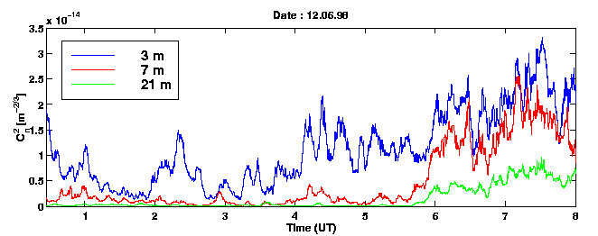
Typical values of C_{N}²
Index of refraction structure function
D_{N} ( r ) = < [ N (x ) - N ( x + r ) ]² > = C_{N}² r ^{2/3}
Night-time boundary layer: C_{N}² ~ 10⁻¹³ - 10⁻¹⁵ m^{-2/3}
10⁻¹⁴
Paranal, Chile, VLT

Slide 46
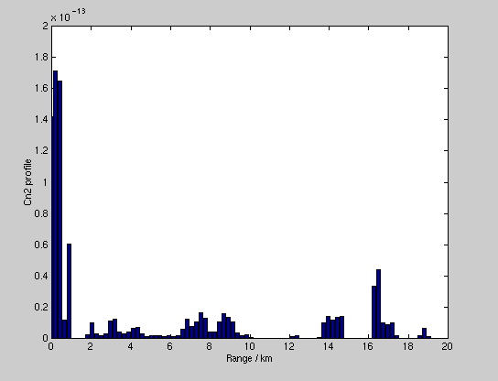
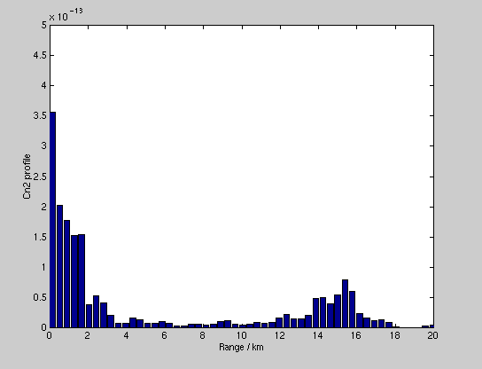
Turbulence profiles from SCIDAR
Eight minute time period (C. Dainty, NUI)
Siding Spring, Australia
Starfire Optical Range, Albuquerque NM

Slide 47
Atmospheric Turbulence: Main Points
Dominant locations for index of refraction fluctuations: atmospheric boundary layer and tropopause
Atmospheric turbulence (mostly) obeys Kolmogorov statistics
Kolmogorov turbulence is derived from dimensional analysis (heat flux in = heat flux in turbulence)
Structure functions derived from Kolmogorov turbulence:
All else will follow from these points!

Slide 49
Part 2: Effect of turbulence on spatial coherence function of light
We will use structure functions D ~ r^{2/3}
to calculate various statistical properties of light propagation thru index of refraction variations

Slide 50
Definitions - Structure Function and Correlation Function
Structure function: Mean square difference
Covariance function: Spatial correlation of a function with itself

Slide 51
Relation between structure function and covariance function
Structure function
Covariance function
A problem on future homework:
  Derive this relationship
  Hint: expand the product in the definition of D_{ϕ} ( r ) and assume homogeneity to take the averages

Slide 52
Definitions - Spatial Coherence Function
Spatial coherence function of field is defined as
        Covariance for complex fn’s
    Note that Hardy calls this function but I’ve called it C_{Ψ} (r) in order to avoid confusion with the correlation function B_{ϕ} ( r ) . C_{Ψ} (r) is a measure of how “related” the field Ψ is at one position (e.g. x) to its values at neighboring positions (say x + r ).

Slide 53
Now evaluate spatial coherence function C_{Ψ} (r)
For a Gaussian random variable with zero mean, it can be shown that
So
So finding spatial coherence function C_{Ψ} (r) amounts to evaluating the structure function for phase D_{ϕ} ( r ) !

Slide 54
Solve for D_{ϕ}( r ) in terms of the turbulence strength C_{N}² (1)
We want to evaluate
Recall that
So next we need to know the phase covariance:

Slide 55
Solve for D_{ϕ}( r ) in terms of the turbulence strength C_{N}² (2)
But for a wave propagating vertically (in z direction) from height h to height h + δh.
Here n(x, z) is the index of refraction.
Hence

Slide 56
Solve for D_{ϕ}( r ) in terms of the turbulence strength C_{N}² (3)
Change variables:
Then

Slide 57
Solve for D_{ϕ}( r ) in terms of the turbulence strength C_{N}² (4)
Now we can evaluate phase structure function D_{φ}( r )

Slide 58
Solve for D_{ϕ}( r ) in terms of the turbulence strength C_{N}² (5)
But

Slide 59
Finally we can evaluate the spatial coherence function C_{Ψ} (r) (!)
For a slant path you can add factor ( sec θ )^{5/3} to account for dependence on zenith angle θ
Concept Question: Note the scaling of the coherence function with separation, wavelength, turbulence strength. Think of a physical reason for each.

Slide 60
Given the spatial coherence function, calculate effect on telescope resolution
Outline of derivation:
Define optical transfer functions of telescope, atmosphere
Define r₀ as the telescope diameter where the two optical transfer functions are equal
  OTF_{telescope} = OTF_{atmosphere}
Calculate expression for r₀

Slide 61
Define optical transfer function (OTF)
Imaging in the presence of imperfect optics (or aberrations in atmosphere): in intensity units
Image = Object Point Spread Function
Take Fourier Transform:
Optical Transfer Function = Fourier Transform of PSF
convolved with

Slide 62
Examples of PSF’s and their Optical Transfer Functions
Seeing limited PSF
Seeing limited OTF
Intensity
θ
θ⁻¹
λ / D
λ / r₀
r₀ / λ
D / λ
Diffraction limited PSF
Diffraction limited OTF
Intensity
θ
θ⁻¹
λ / D
λ / r₀
r₀ / λ
D / λ

Slide 63
Next time: Derive r₀ and all the good things that come from knowing r₀
Define r₀ as the telescope diameter where the optical transfer functions of the telescope and atmosphere are equal
Use r₀ to derive relevant timescales of turbulence
Use r₀ to derive “Isoplanatic Angle”:
  AO performance degrades as astronomical targets get farther from guide star

